Slide 1
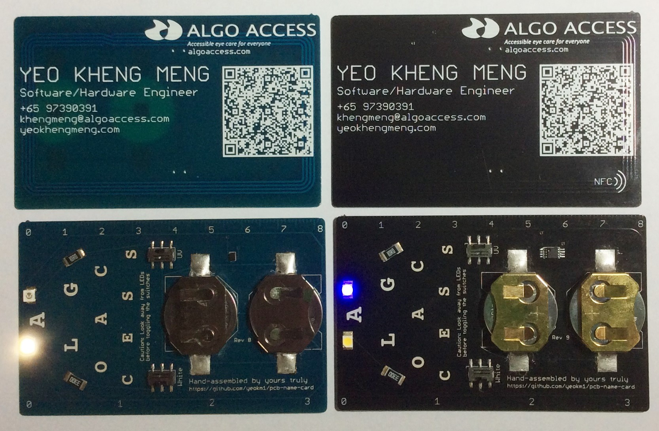
My PCB Business Card
By: Yeo Kheng Meng (yeokm1@gmail.com)
https://github.com/yeokm1/pcb-name-card
http://yeokhengmeng.com/2015/09/pcb-businessname-card/
Hackware v1.5 (24 Feb 2016)

Slide 2
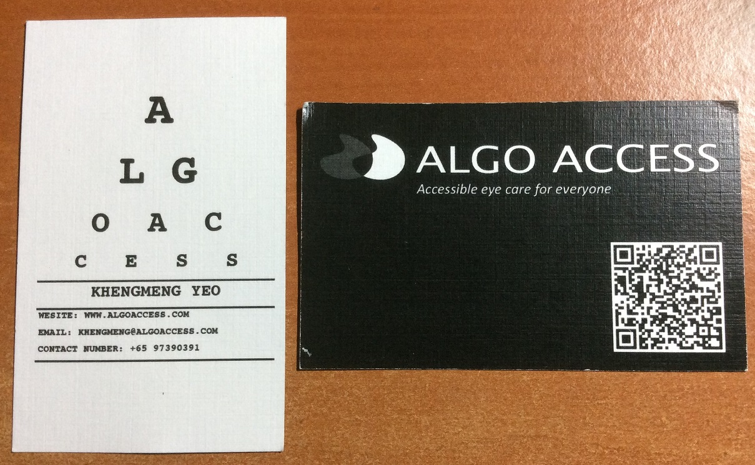
Backstory
(June 2015)
The spelling mistake

Slide 3
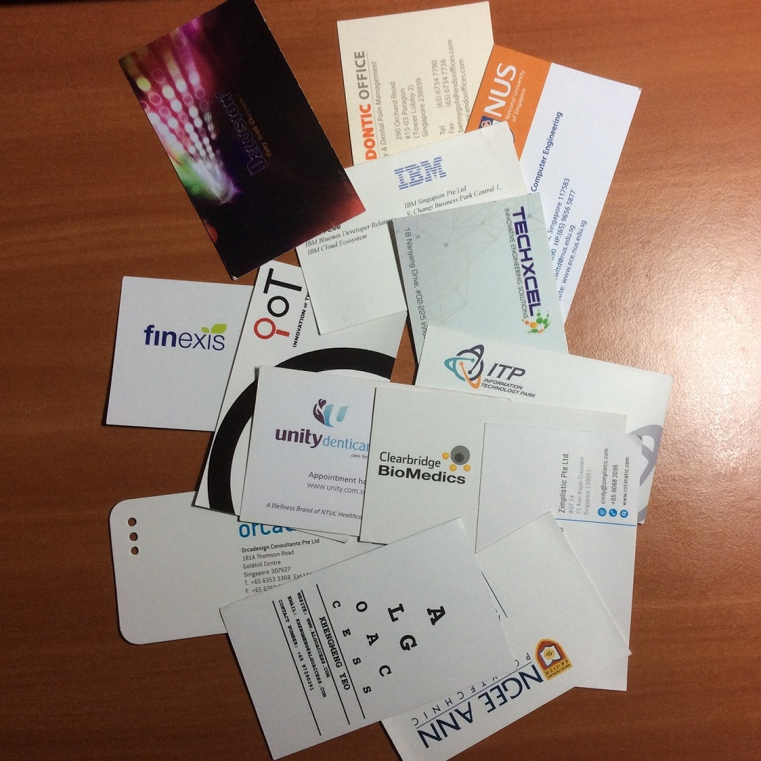
Typical business cards
X
Plain
Boring
Forgettable

Slide 4
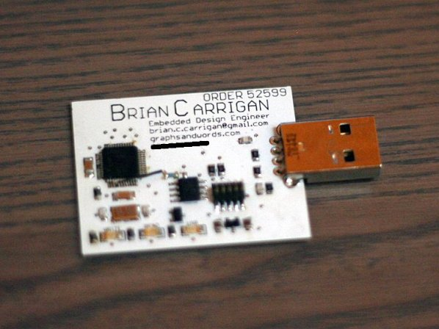
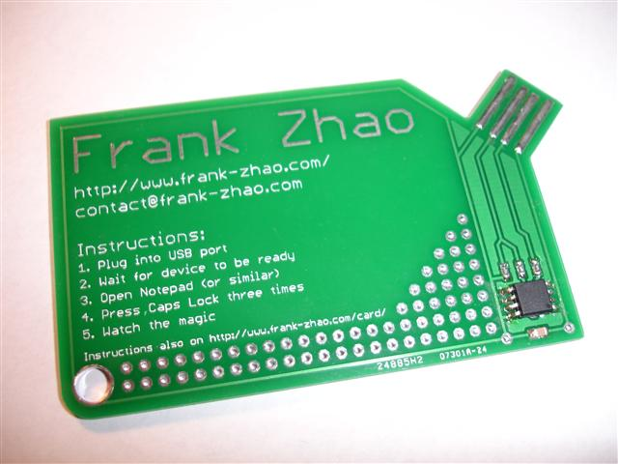
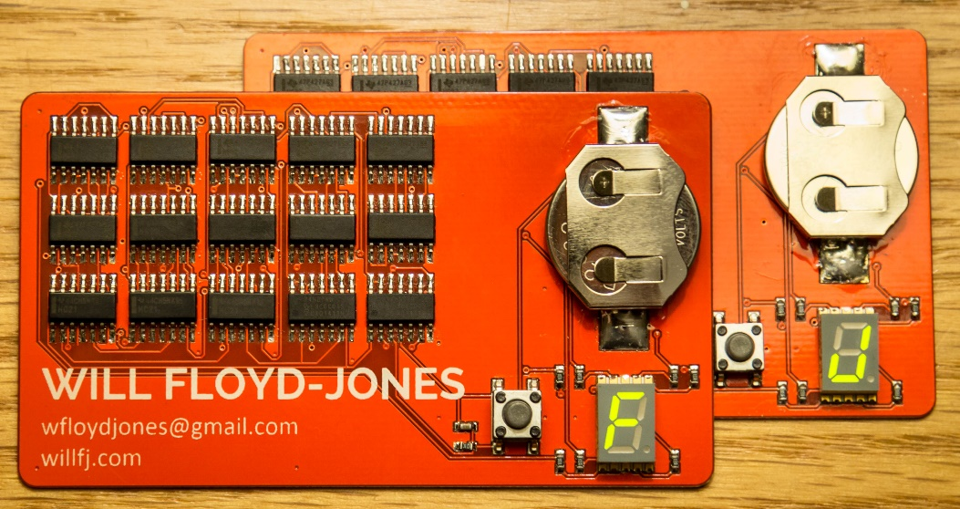
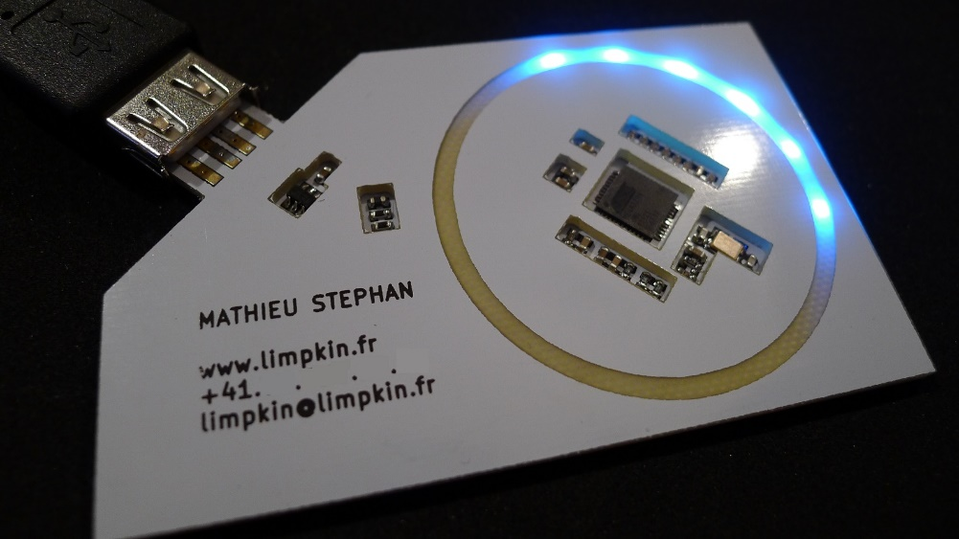
Existing PCB business cards
Flash Drive emulation: http://makezine.com/2012/08/22/pcb-business-card-2/
USB keyboard entry: http://eleccelerator.com/usb-business-card/
Logic gates: http://willfj.com/pcb-business-card/
Light ring: http://www.limpkin.fr/index.php?post/2014/06/16/My-business-card-v2

Slide 5
Goals of my business card
Be different
Be useful
Appear expensive but not too expensive

Slide 6
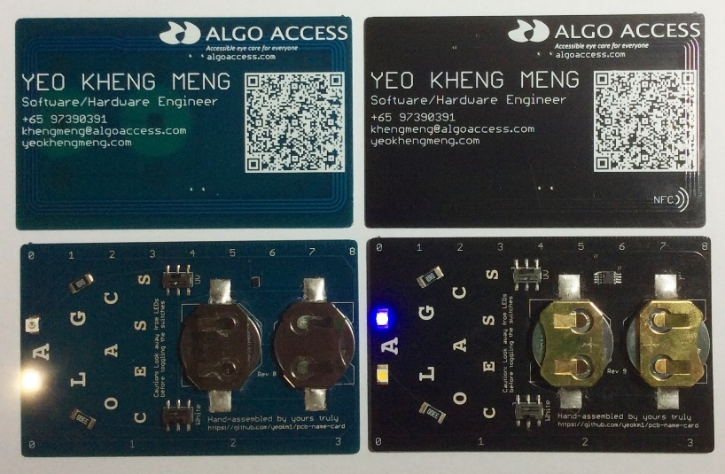
Feature goals
White LED
Ultraviolet LED
Ruler
Quick adding of my contact
QR code
NFC (Prototype stage)

Slide 7
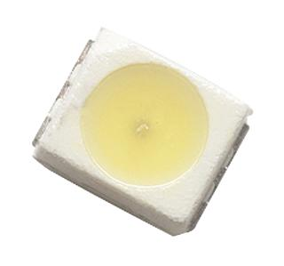
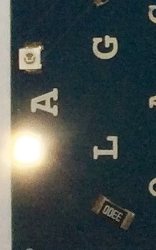
White LED (torch)
Avago Neutral White
PLCC-2 package (3.2 x 2.8 x 1.9mm)
Add 330 ohm resistor to ↓ current
1mA current

Slide 8
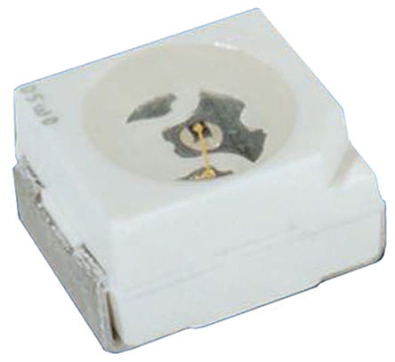
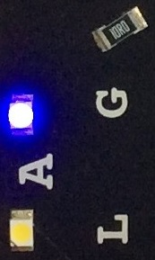
Ultraviolet LED
Vishay
PLCC-2 package (3.2 x 2.8 x 1.9mm)
405nm (near-UV)
Current usage ~3mA

Slide 9
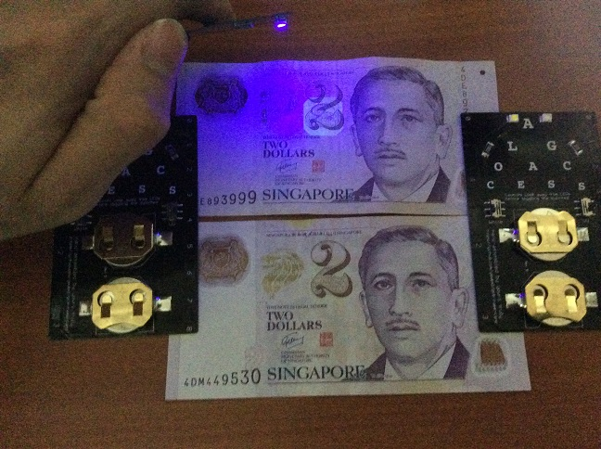
UV LED in action

Slide 10
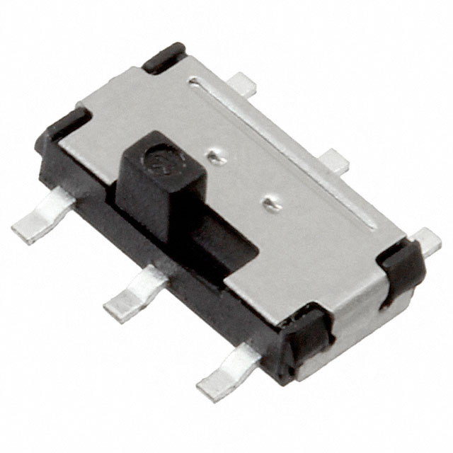
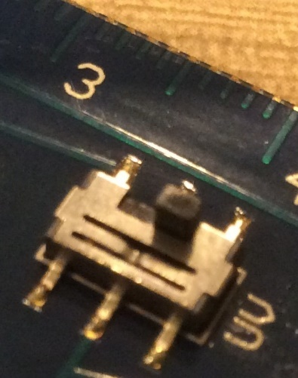
Switches
C&K Components DPDT slide switch
3mm height

Slide 11
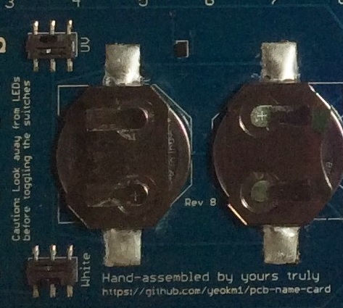
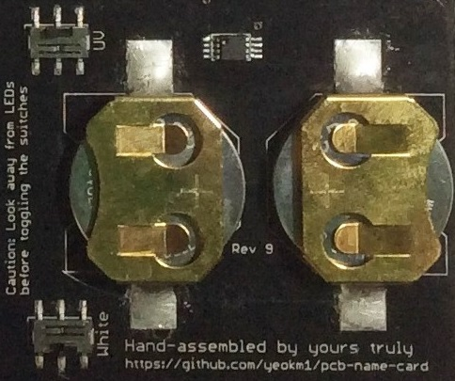
Young Blue vs Formal Black
Young Blue
CR2016 holders
2.8mm holder height
Can tightly-fit CR2025 batteries
NFC storage: 888 bytes
Formal Black (Appears more “atas”)
CR2032 batteries with gold-plated holder
4.3mm holder height
NFC storage: 1904 bytes

Slide 12

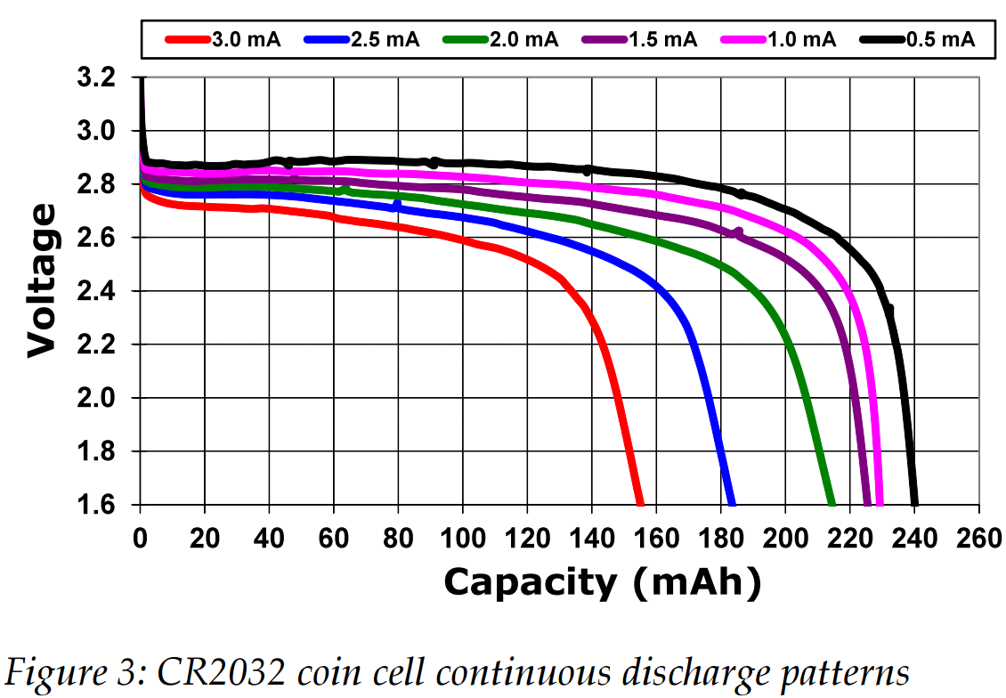
Why 2 batteries?
Coin cells connected in parallel to reduce current load
High currents reduce overall battery capacity
Two batteries results in >2x single battery life
Source:
Nordic Semiconductor, Sept 2011: High pulse drain impact on CR2032 coin cell battery capacity
http://m.eet.com/media/1121454/c0924post.pdf

Slide 13
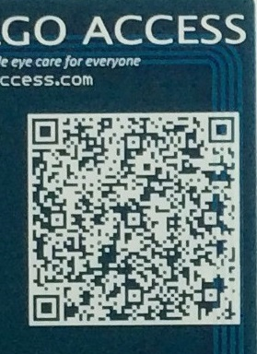
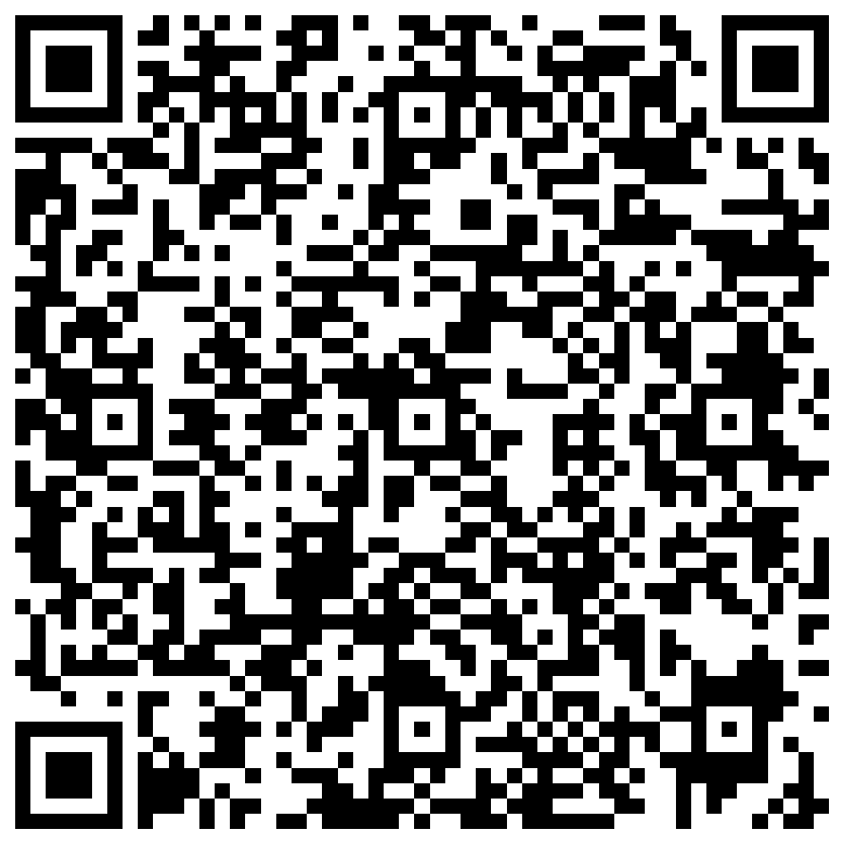
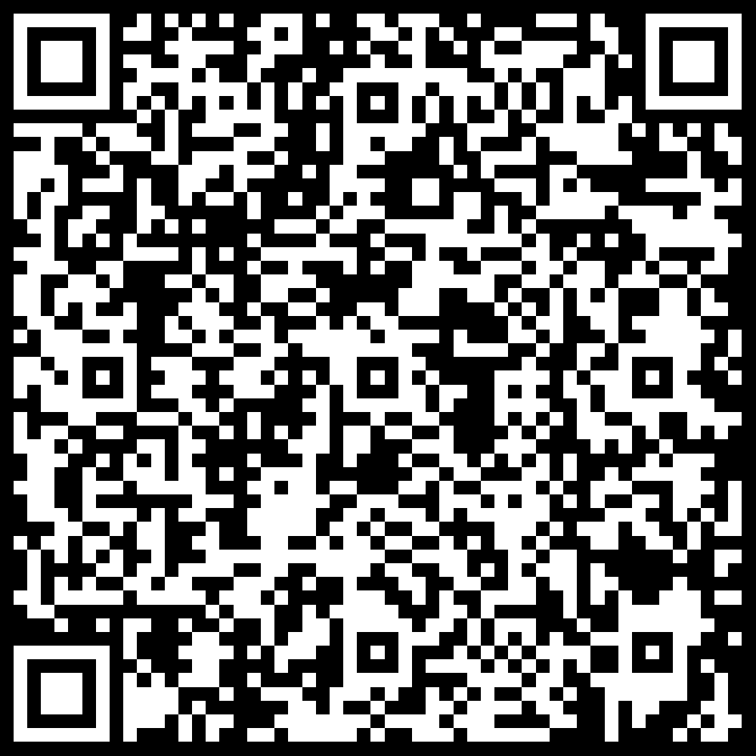
Quick contact adding: QR Code
QR code contains vCard
BEGIN:VCARD
N:Yeo;Kheng Meng
EMAIL:khengmeng@algoaccess.com
ORG:Algo Access Pte Ltd
TEL;CELL:+65 97390391
TITLE:Software/Hardware Engineer
URL;WORK:http://algoaccess.com
URL:http://yeokhengmeng.com
END:VCARD
Generated QR code requires colour inversion
Black is printed as white in white silkscreen
Any graphics software including MS Paint can do this
iOS Demo

Slide 14
Quick contact adding: NFC (1)
NFC chip contains vCard
vCard contains extra info as NFC chip memory > 300 bytes for optimum QR Code
BEGIN:VCARD
N:Yeo;Kheng Meng
EMAIL:khengmeng@algoaccess.com
EMAIL:yeokm1@gmail.com
ORG:Algo Access Pte Ltd
TEL;CELL:+65 97390391
TITLE:Software/Hardware Engineer
URL;WORK:http://algoaccess.com
URL:http://yeokhengmeng.com
URL:https://www.linkedin.com/in/yeokhengmeng
END:VCARD
Young Blue’s NFC chip
NXP NTAG216 (NT2H1611)
HXSON-4/SOT1312-1 package (1.5mm x 2mm)
888 bytes
50pf input capacitance
Formal Black’s NFC chip
NXP NTAG I²C (NT3H1201)
TSSOP-8 package (5mm x 3mm)
1904 bytes
50pf input capacitance

Slide 15
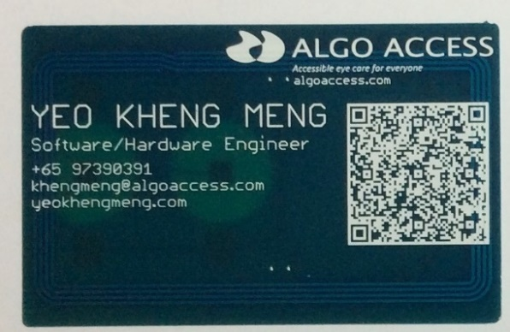
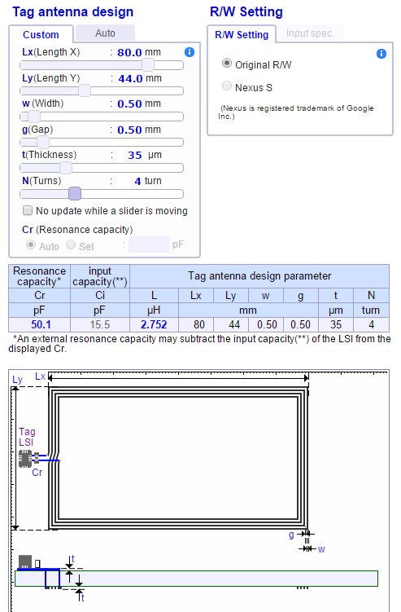
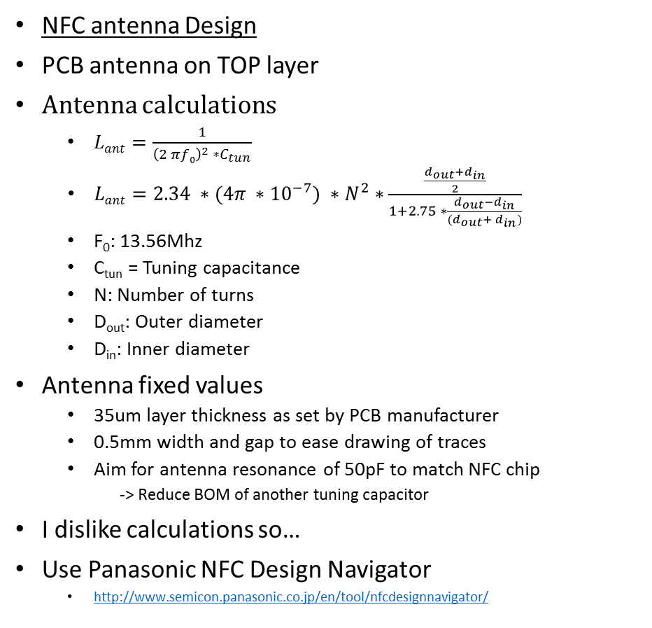
Quick contact adding: NFC (2)
NFC antenna Design
PCB antenna on TOP layer
Antenna calculations
$Lant=\frac{1}{{\left(2 πf0\right)}^{2} ∗C_{tun}}$
$Lant=2.34 ∗(4π ∗{10}^{−7}) ∗N^{2}∗\frac{\frac{d_{out}+d_{in}}{2}}{1+2.75 ∗\frac{d_{out}−d_{in}}{(d_{out}+ d_{in})}}$
F₀: 13.56Mhz
C_{tun} = Tuning capacitance
N: Number of turns
D_{out}: Outer diameter
D_{in}: Inner diameter
Antenna fixed values
35um layer thickness as set by PCB manufacturer
0.5mm width and gap to ease drawing of traces
Aim for antenna resonance of 50pF to match NFC chip
-> Reduce BOM of another tuning capacitor
I dislike calculations so…
Use Panasonic NFC Design Navigator
http://www.semicon.panasonic.co.jp/en/tool/nfcdesignnavigator/
Antenna calculations source:
http://www.st.com/st-web-ui/static/active/jp/resource/technical/document/application_note/CD00221490.pdf

Slide 16
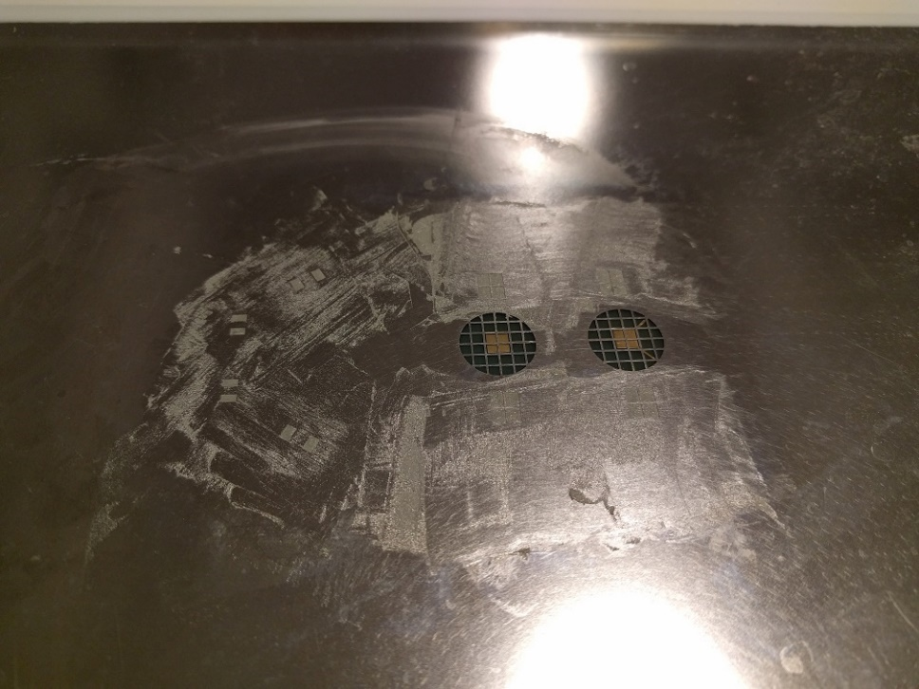
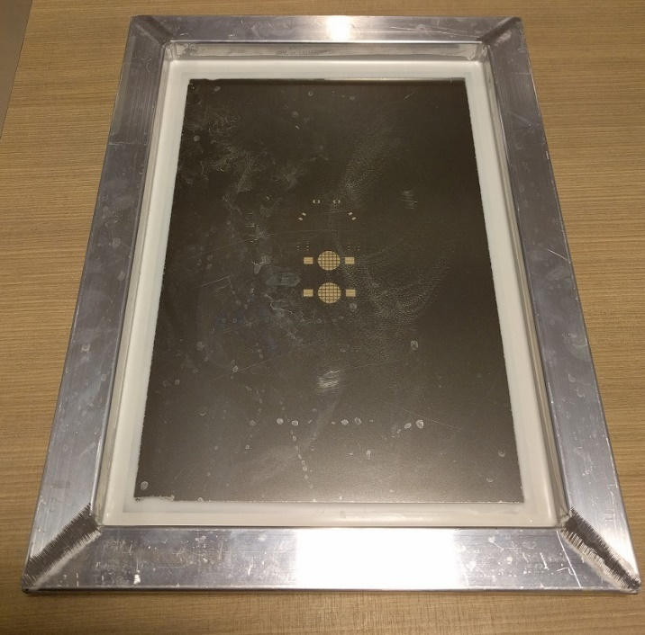
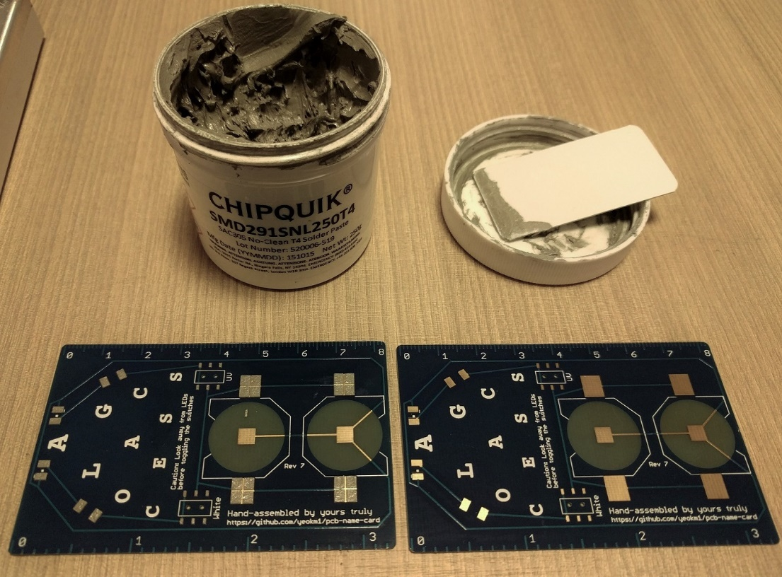
Assembly Process 1
Stencil and solder paste

Slide 17
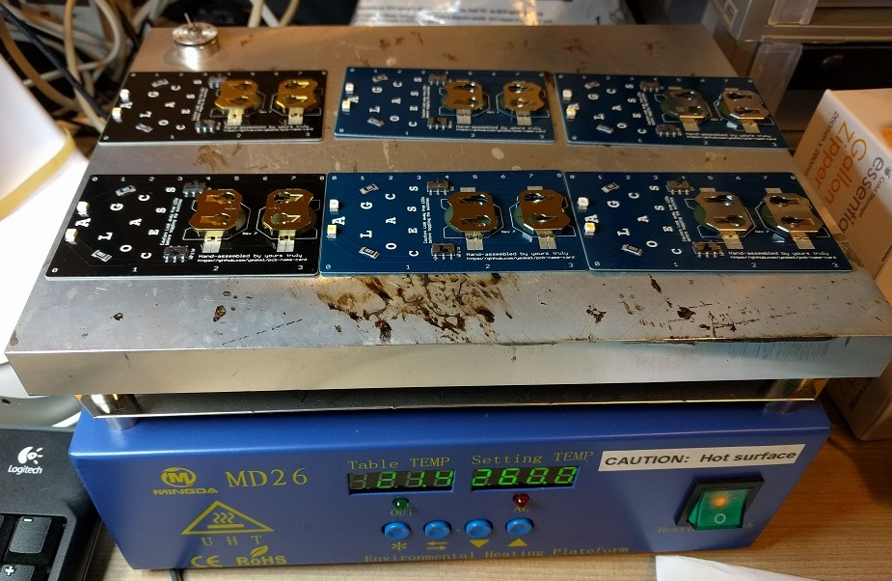
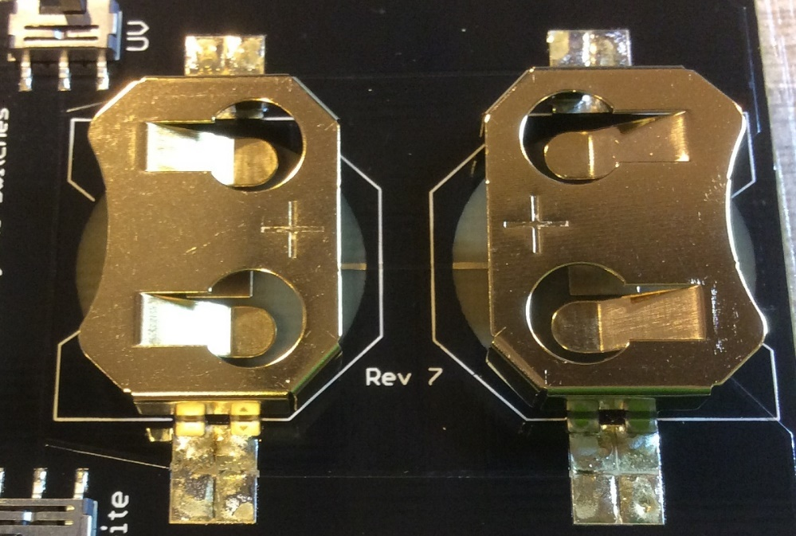
Assembly Process 2
Hot plate reflow soldering
Hand soldering for battery holders

Slide 18
Cost (SGD)
Pieces | Young Blue | Formal Black
10 | $15.53 | $17.19
50 | $10.53 | $12.26

Slide 19
Future work (Concept card)
Only for special case
Sensor suite
Bosch BME280: temperature and humidity sensor
Maxim MAX30100: Pulse Oximeter and Heart-Rate Sensor
Silicon Labs SI1145: UV Sensor
Texas Instruments TMP007: IR thermometer
OLED screen
Bluetooth Low Energy
Rigado BMD-300 or Raytac MDBT42 nRF52 module
LIR2450 3.6V rechargeable coin-cell
Microchip MCP73831 battery charging IC

Slide 20
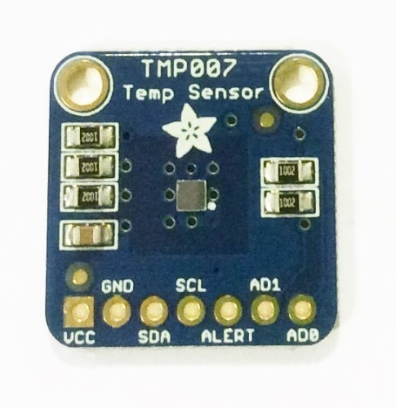
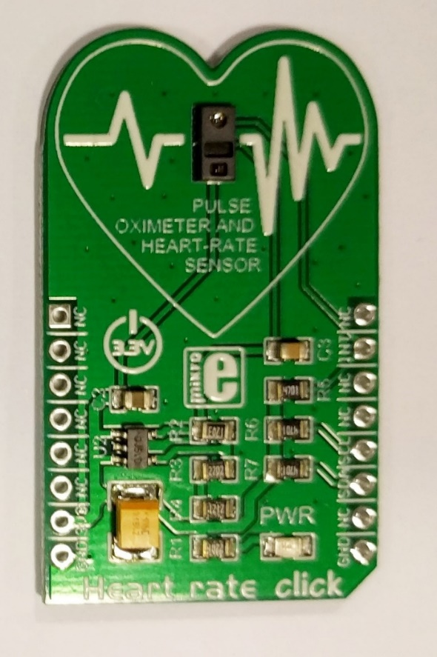
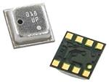
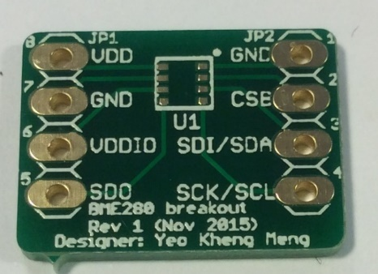
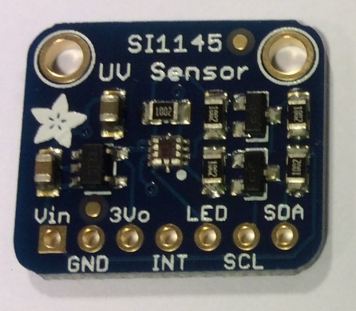
Sensor breakouts
TMP007 breakout
IR Thermometer
By Adafruit
Bosch BME280 breakout
Temperature & humidity
https://github.com/yeokm1/pcb-bme280-breakout
Maxim MAX30100 breakout
Pulse Oximeter & Heart-Rate Sensor
By MicroElektronika
SI1145 breakout
UV Sensor
By Adafruit

Slide 21
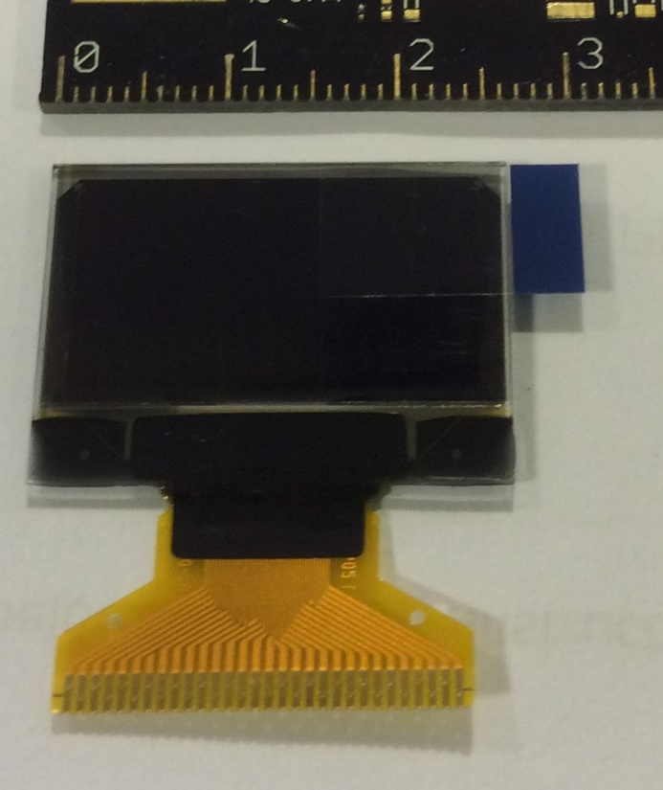
OLED screen
3cm x 1.5cm
128 x 64 pixels. 0.96” diagonal
Univision Technology UG-2864HSWEG01

Slide 22
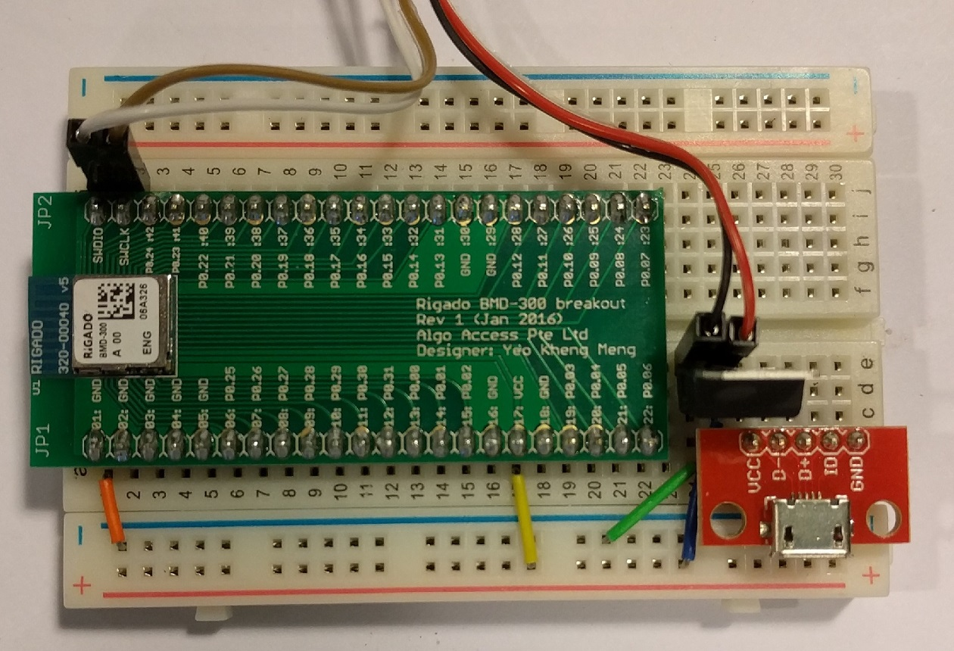
Rigado BMD-300 BLE module
Sample nRF52 module
https://github.com/algoaccess/pcb-breakout-bmd300

Slide 23
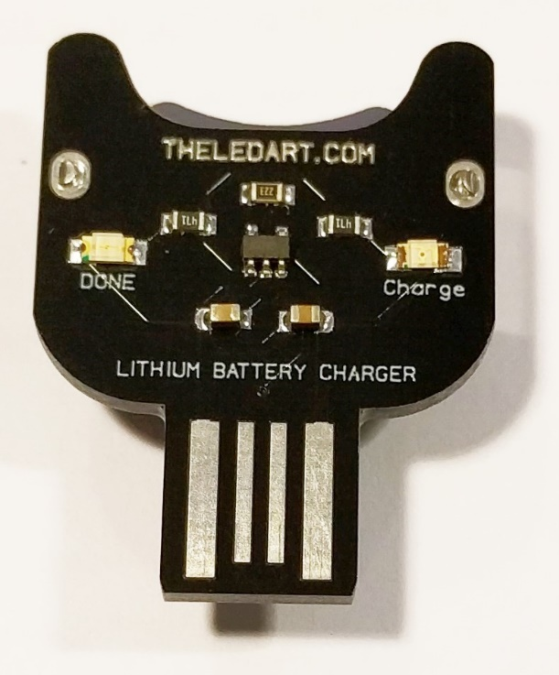
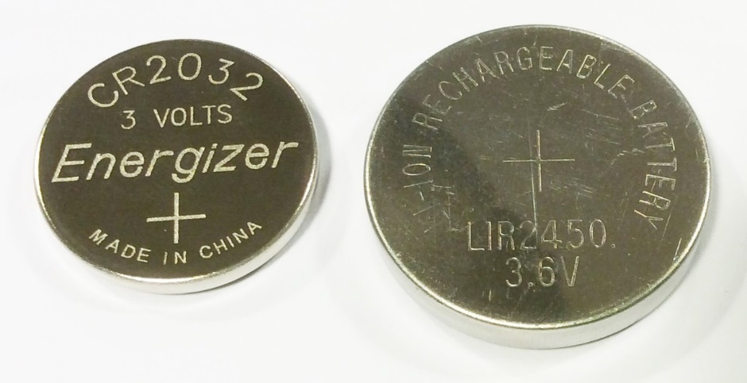
Power source
LIR2450 rechargeable cell
3.6V 120mAh
24.5mm x 5mm
LIR2450 charger
By: theledart
Based on MCP73831

Slide 24
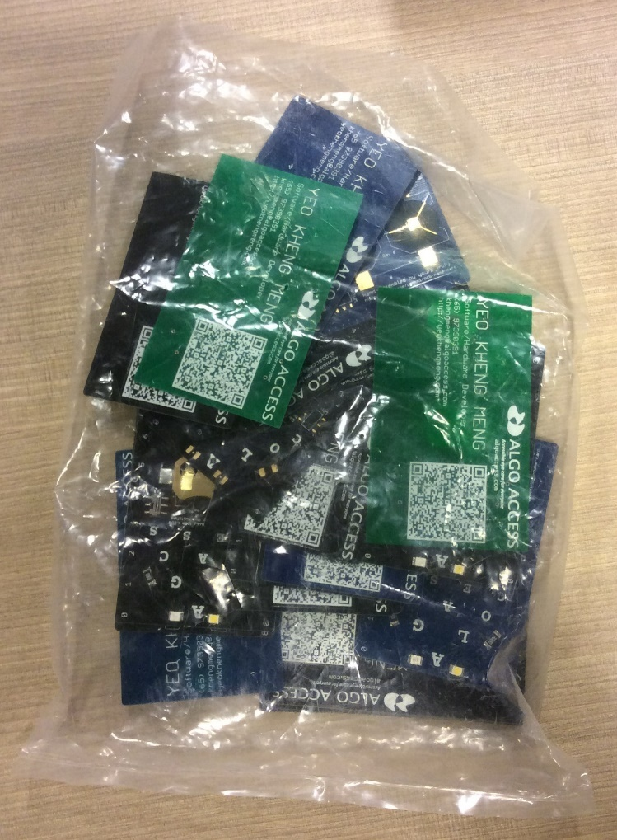
The End
Help yourselves to the rejected cards
By: Yeo Kheng Meng (yeokm1@gmail.com)
https://github.com/yeokm1/pcb-name-card
http://yeokhengmeng.com/2015/09/pcb-businessname-card/
Hackware v1.5 (24 Feb 2016)

